Slide 1
Employee Management Analysis
SUMMER INTERNSHIP REVIEW | JAVA FULL STACK
Using Java Full Stack
Surjith S | 810023205031
Department of Information Technology, University College of Engineering, BIT Campus
Anna University, Tiruchirappalli – 620 024 • IT3711 • Academic Year 2026–2027
Notes:
Good morning. I am Surjith S from the Department of Information Technology. This review covers my one-month Java Full Stack internship at Besant Technologies, Chennai, and the project I built there: Employee Management Analysis.

Slide 2
One month of hands-on Java Full Stack training
INTERNSHIP OVERVIEW
Where and when
Technologies used
Four-week plan
Besant Technologies, Chennai
Java: application logic and data access
Week 1: Java basics and OOP
01 – 30 June 2026
HTML, CSS, JavaScript: pages and validation
Week 2: HTML, CSS, JavaScript
10:00 AM to 04:00 PM daily
Week 3: SQL and database design
Domain: Java Full Stack Development
SQL: tables, queries and reports
Week 4: Project build, testing, documentation
Employee Management Analysis
02 / 15
Notes:
I trained at Besant Technologies in Chennai from 1 to 30 June 2026, from 10 AM to 4 PM. The month followed a plan: Java and OOP first, then the front end, then SQL and database design, and finally the project itself with testing and documentation.

Slide 3
Employee records need structure, checks and control
SYSTEM STUDY | PROBLEM IDENTIFICATION
Scattered data
Duplicate and incomplete entries
Employee details are kept in separate files, so one record can exist in several versions.
Without mandatory fields and unique keys, repeated IDs and missing values slip in.
Slow search and reports
No access control
Finding one employee or counting people per department means going through every file.
Anyone with the data can change it; there is no difference between who may view and who may edit.
Employee Management Analysis
03 / 15
Notes:
These are the four problems the project answers: scattered data, duplicate or incomplete entries, slow search and reporting, and no control over who can change records. Each one maps to a feature on the next slides: a single database, validation and constraints, search and reports, and role-based access.

Slide 4
A web application with a relational database
PROPOSED SOLUTION AND DATA
Solution
Data managed
HTML, CSS and JavaScript front end
Java back end with a separate data-access class
SQL database for employee, department and user data
Admin: add, view, search, update, delete, report
Viewer: log in, view and search only
Checks in the browser and again on the server
Employee: ID, name, email, phone, designation, joining date, status (ACTIVE / INACTIVE)
Department: ID, name, location
Users: username, encrypted password, role (ADMIN / VIEWER)
Employee Management Analysis
04 / 15
Notes:
The solution is a web application. The browser handles the pages and the first round of validation, Java handles the logic, and SQL stores the data in three tables: employee, department and users. Admins can do everything; viewers can only read and search.

Slide 5
Three-layer system architecture
ARCHITECTURE
Presentation layer
Web browser • HTML page structure • CSS styling • JavaScript validation
HTTP request and HTTP response
Application layer (Java)
Servlets / controllers • business logic and validation • DAO classes (JDBC)
SQL query and result set
Database layer (SQL)
employee table • department table • users table
Employee Management Analysis
05 / 15
Notes:
Each layer talks only to the layer next to it. The browser sends HTTP requests to the Java application, the Java application sends SQL queries to the database, and the results travel back the same way until they are shown to the user.

Slide 6
Four processes, each with one job
FUNCTIONAL MODULES
1.0
2.0
User authentication
Manage employees
Login, credential check against the users table, role identified, logout.
Add, view, update (ID read-only) and delete with a confirmation dialog.
3.0
4.0
Search employees
Generate reports
Search by ID, name or department, with a clear “No records found” message.
Department-wise totals, active and inactive counts, with a bar chart.
Employee Management Analysis
06 / 15
Notes:
The data flow diagram splits the system into four processes: authenticate user, manage employees, search employees and generate reports. Authentication reads the users store, management reads and writes the employee store, and reports read both employee and department data.

Slide 7
Separation of concerns in code
IMPLEMENTATION AND DEVELOPMENT
Front end: labelled forms; validateForm() checks name and email before submit
Back end: Employee model plus an EmployeeDAO that holds all SQL
MVC: servlet controller selects the view and calls the model
PreparedStatement: values are bound as data, which protects against SQL injection
Errors: database exceptions, such as a duplicate ID, become clear user messages
PROJECT STRUCTURE
java/model: Employee
java/dao: DBConnection, EmployeeDAO
java/controller: LoginServlet, EmployeeServlet, ReportServlet
webapp: login, dashboard, employees, add / edit pages
webapp/css, js: style.css, validate.js
database: schema.sql
Employee Management Analysis
07 / 15
Notes:
The project is split into model, data-access, controller and web pages, following the separation of concerns principle. All SQL sits in the DAO class and uses PreparedStatement, so user input is treated as data and not as part of the command. Validation happens in JavaScript for convenience and again on the server for safety.

Slide 8
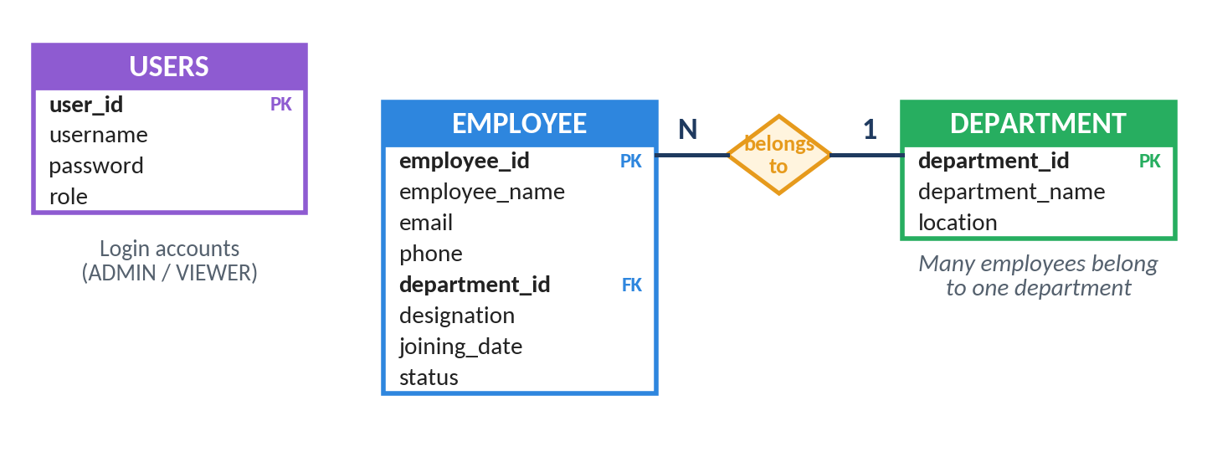
Three tables, one foreign key
DATABASE DESIGN
employee: primary key employee_id; email UNIQUE NOT NULL; status defaults to ACTIVE
department: department_name UNIQUE NOT NULL
Foreign key department_id: no employee can join a department that does not exist
users: login accounts with role ADMIN or VIEWER
Figure 3.2: Entity-Relationship diagram
Employee Management Analysis
08 / 15
Notes:
Many employees belong to one department, so department_id in the employee table is a foreign key to the department table. The department name is stored only once. The users table is independent and holds only login information. Constraints such as primary key, unique and not null protect the data even if the application makes a mistake.

Slide 9
CRUD, grouping and joins
SQL OPERATIONS
Create and read
Update and delete
INSERT INTO employee VALUES (…);
UPDATE employee SET designation =
SELECT * FROM employee
'Senior Developer' WHERE employee_id = 1;
WHERE department_id = 1;
DELETE FROM employee WHERE employee_id = 1;
Aggregation report
Relational query
SELECT department_id,
SELECT e.employee_name, d.department_name
COUNT(*) AS total_employees
FROM employee e INNER JOIN department d
FROM employee GROUP BY department_id;
ON e.department_id = d.department_id;
Employee Management Analysis
09 / 15
Notes:
These are the statements I executed on the employee table. GROUP BY with COUNT gives the department-wise numbers that appear on the report page, and the INNER JOIN shows each employee with the department name instead of the department number. A second INSERT with the same ID was rejected by the primary key constraint.

Slide 10
Least privilege for every role
SECURITY AND ROLE-BASED ACCESS
Operation | Admin | Viewer
Login, logout | Yes | Yes
View list, search, department report | Yes | Yes
Add employee | Yes | No
Update employee | Yes | No
Delete employee (confirmation required) | Yes | No
Roles are checked in the Java application, not only in the page. A viewer who types the delete address directly still receives 403 Access Denied, and no data changes.
Employee Management Analysis
10 / 15
Notes:
Hiding buttons is not security, because a restricted page can still be requested by typing its address. So the Java application checks the role again on the server. Passwords are stored in encrypted form in the users table, and every user gets only the access the work requires.

Slide 11
Test cases TC-01 to TC-11
TESTING AND RESULTS
What was tested
Results and lessons
Valid and invalid login
Add employee: valid data, empty name, duplicate ID, email without @
Search: existing ID and unknown ID
Update a designation; delete with confirmation
Special characters such as quotes and symbols in a name
Each case has an output screen showing the expected result
Duplicate IDs and bad input are rejected with a simple message, not a technical error
Challenge: mixed logic and SQL. Fix: a separate data-access class
Challenge: SQL errors. Fix: test each query on sample data first
Employee Management Analysis
11 / 15
Notes:
I wrote test cases for login, form validation, create, read, update, delete, search and special characters. Section 4.7 of the report links every output screen to the requirement or test case it demonstrates. The main difficulties were understanding how browser, Java and database connect, and keeping SQL out of the interface code, which I solved with a separate data-access class.

Slide 12
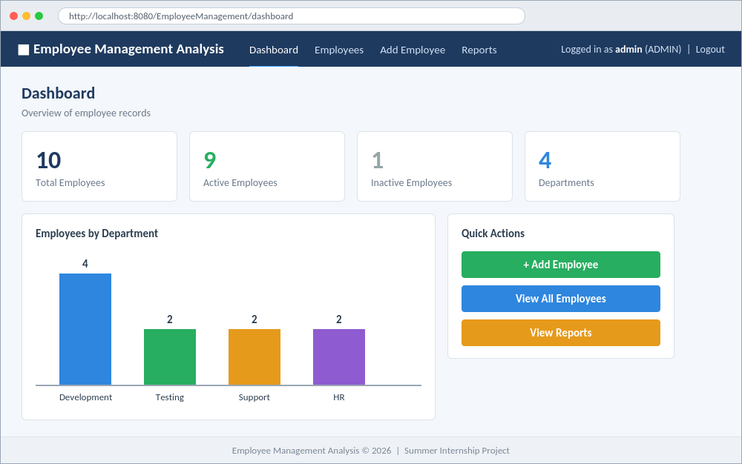
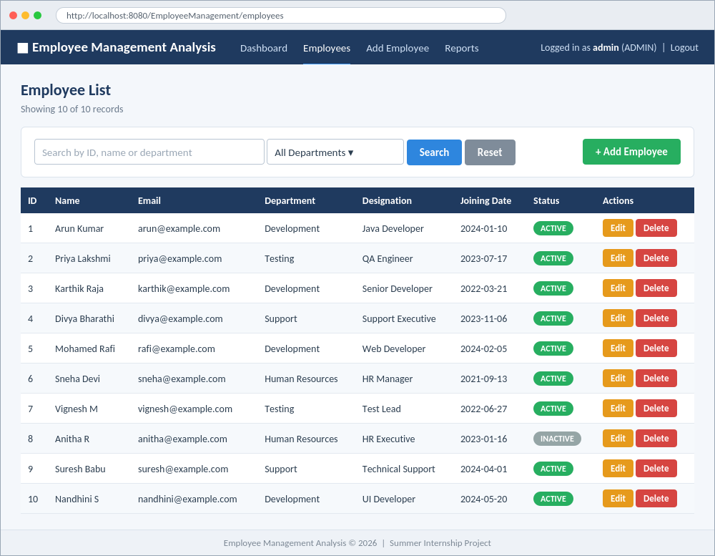
Dashboard and employee list
OUTPUT SCREENSHOTS | 1
Figure 4.4: Dashboard
Figure 4.5: Employee list
Employee Management Analysis
12 / 15
Notes:
After login the dashboard shows total, active and inactive employees, the number of departments and a bar chart per department. The employee list shows every record with a coloured status label, plus search, department filter and Edit and Delete buttons for admins.

Slide 13
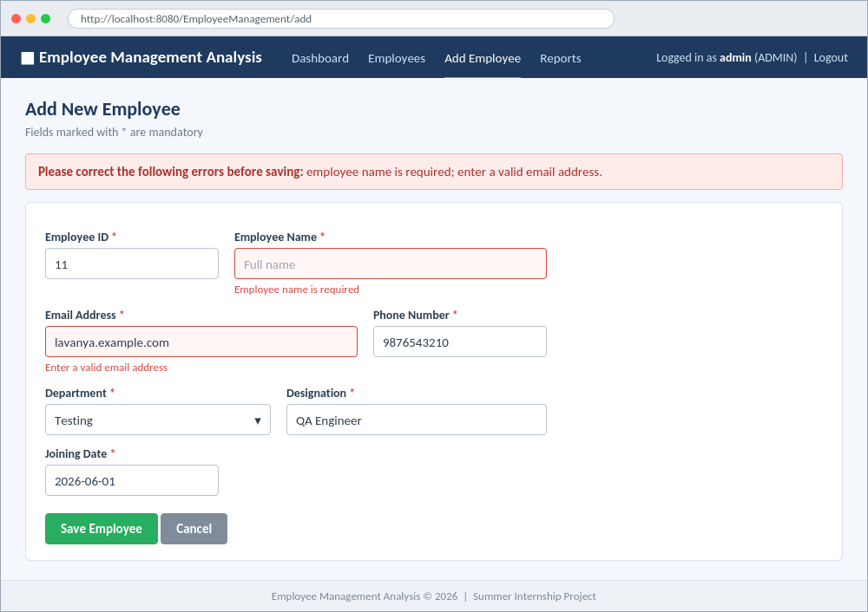
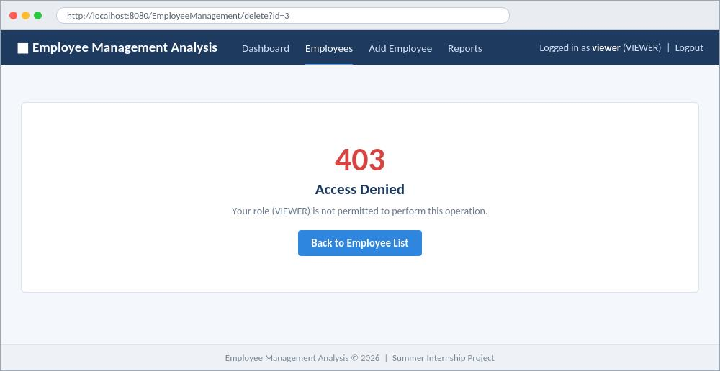
Validation and access control
OUTPUT SCREENSHOTS | 2
Figure 4.7: Client-side validation
Figure 4.17: Access Denied for a viewer
Employee Management Analysis
13 / 15
Notes:
On the left, JavaScript highlights an empty name and an email without the @ symbol and blocks the form until both are fixed. On the right, a viewer who requests the delete address directly gets a 403 Access Denied page and no data is changed.

Slide 14
From classroom theory to a working application
CONCLUSION AND KEY LEARNING
Conclusion
Skills gained
Completed the Java Full Stack internship at Besant Technologies, Chennai
Built Employee Management Analysis with CRUD, search, reports and role-based access
Used HTML, CSS and JavaScript for the interface, Java for logic and SQL for data
Bridged the gap between academic learning and industry practice
Object-oriented programming in Java
Web pages with HTML and CSS; validation with JavaScript
Relational database design and SQL queries
How front end, back end and database connect
Preparing test cases and checking application behaviour
Employee Management Analysis
14 / 15
Notes:
To conclude: the internship gave me practical skills in Java, HTML, CSS, JavaScript and SQL, and the Employee Management Analysis project showed how these fit together in a real web application. It also improved my analytical thinking and problem-solving, and gives me a base for future projects in full stack development.

Slide 15
Thank you
Surjith S | 810023205031
Department of Information Technology, University College of Engineering, BIT Campus, Anna University, Tiruchirappalli
Notes:
Thank you. I am happy to take any questions.

